Slide 1
Analysis of Unemployment Index

Slide 2
Gopalakrishnan Kumar, M.Tech IIT Bombay
Freelance Data Science Consultant
LinkedIn URL – https://www.linkedin.com/in/gopalakrishnan-kumar-a73301110/
Git Repository https://github.com/Gopalakrishnan-Kumar/Python-for-Data-Science
Website/blog URL https://www.kaggle.com/gopalkk1

Slide 3


Project Goals
Objectives
Constraints
To classify the unemployment index of survival and unemployment group with respect to timeline estimate using Supervised Machine Learning method.
To apply suitable machine learning model for classifying the unemployment index with respect to spell and event
To create awareness of unemployment rate so as to suggest ways and means to minimize unemployment rate
Inadequate information regarding column names
Missing values
Maximize-Maximize the customer satisfaction by good healthcare services

Slide 4
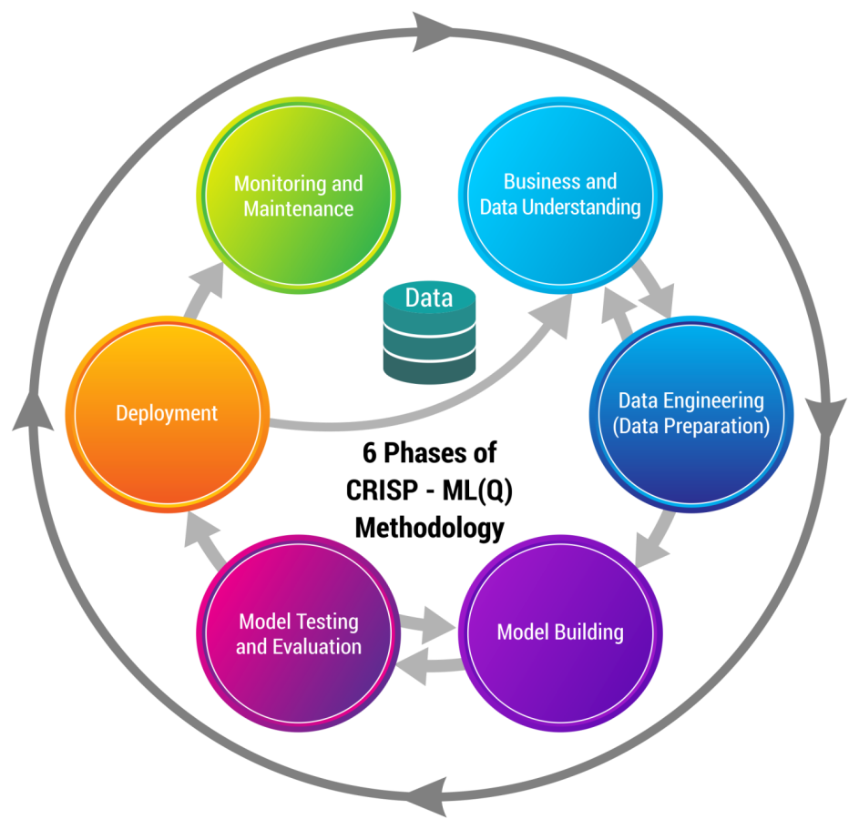
Business pipeline: CRISP-ML(Q) Methodology
Phase 1: Business and Data Understanding
This phase helps us to ensure the feasibility of the project. As the data are available through from team lead the data quality has been assured.
Phase 2: Data Engineering
This includes data selection, data cleaning, feature engineering, and data standardising tasks.
Data Selection- In this phase, filter method is used for data selection.
Data Cleaning- Error detection has been performed in the form of outliers, maximum, minimum, mean, average and mean deviation to all of these.
Feature engineering- In this project clustering and discretization of continuous attributes has been performed.
Data Standardization- In this process, the ML tools’ input data are unified.
Data preprocessing has been done to ready the model fitting procedure by replacing with NA, NaN and so on. This enhances data reusability.

Slide 5
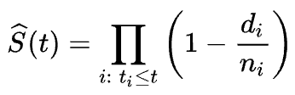
Business pipeline: CRISP-ML(Q) Methodology
Phase 3: Machine Learning Model Engineering
Business and data understanding phase will shape this phase. Model assessment metrics might include performance metrics, robustness, fairness, scalability, interpretability, model complexity degree and model resource demand.
Model Selection / Specialization-
Kaplan-Meier Estimator
Being a non-parametric estimator, Kaplan-
Meier doesn’t require making initial assumptions about the distribution of data. It also takes care of right-censored observations by computing the survival probabilities from observed survival times. It uses the product rule from probability and in fact, it is also called a product-limit estimator.
where:
d_i: number of events happened at time t_i
n_i: number of subjects that have survived up to time t_i
The survival probability at time t_i is equal to the product of the probability of surviving at prior time t_i-1 and the percentage chance of surviving at time t_i.
Model training tasks-
Pretrained models and ensemble learning methods-

Slide 6
Business pipeline: CRISP-ML(Q) Methodology
Phase 4: Model Testing and Evaluation
Consequently, model training is followed by a model evaluation phase also known as offline testing. Here, the performance of trained model needs to be validated on a test set. Then, the model deployment decision to be taken.
Phase 5: Deployment
The ML model deployment denotes a process of ML model integration into the existing software system.
Phase 6: Monitoring and Maintenance
Once the ML model has been put into production, it is essential to monitor its performance and maintain.

Slide 7








Technical Stacks
Languages: Python, html, cloud, sql, heroku, R, visual studio, git bash
AI/ML: Pytorch, skikitlearn,
Libraries: lifelines, pandas, numpy, skikitlearn
Database: Jupyter Online
Warehouse: Jupyter classic notebook
ETL: Python, Jupyter
Visualizations: Plotly()
Tracking & SC: Github

Slide 8
Project Architecture / Data Pipeline
Project Architecture
Data Exploration
Data Processing and Preprocessing
Explaratory Data Analysis
Model Building
Model Selection/ Specialization
Kaplan Mier Estimator
Model Training Tasks
Model Evaluation
Validation of performance of trained model
Model Deployment- ML model integration into the existing software system/ User acceptance and usability.

Slide 9

Data Preparation
Data used for training the model has been collected from Github and Wikipedia.
Data cleansing- This includes describing mean, standard deviation, average, count, maximum, minimum, and removing NaNs.
Data has been cleaned by removing NaNs.
Outliers have been noted in value_counts()

Slide 10

Model Building
Model Specialization/ Standardization.
Kaplan Meir Fitter Model is the model to be used.
Tasks to be performed

Slide 11
Model Description
Algorithms used:
Kaplan-Meier Estimator
Being a non-parametric estimator, Kaplan-
Meier doesn’t require making initial assumptions about the distribution of data. It also takes care of right-censored observations by computing the survival probabilities from observed survival times. It uses the product rule from probability and in fact, it is also called a product-limit estimator.
where:
d_i: number of events happened at time t_i
n_i: number of subjects that have survived up to time t_i
Descriptions:
Defining the model as ‘Kaplan Meier Fitter ‘
Fitting the model with parameters like Time, Spell, Event
Plot

Slide 12
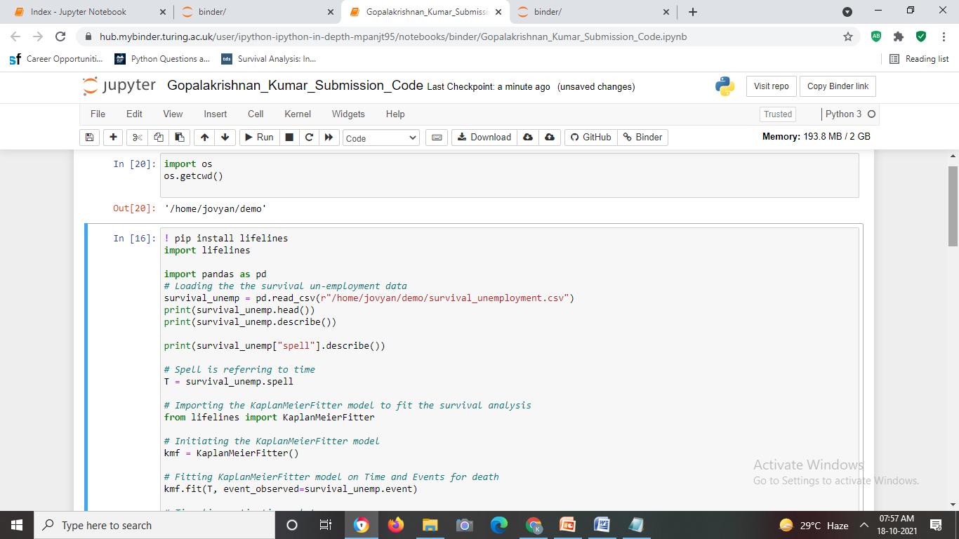
Outputs of the Model in Codes

Slide 13

Deployment Strategy
Web Based- HTML applications
Enterprise Based- AI algorithm/ Kaplan Meier Fitter Model

Slide 14
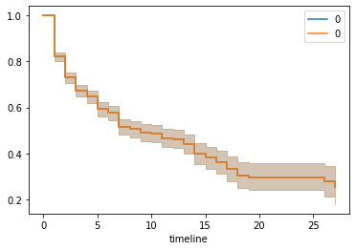
Outputs of the Deployed Model
Graph 1- Time and events from Group “0”
Universal Sentence Encoder:

Slide 15
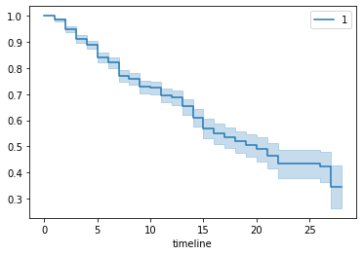
Outputs of the Deployed Model
Graph 2- Time and events from Group “1”

Slide 16
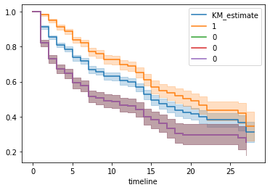
Outputs of the Deployed Model
Graph 3- Time-line estimations plot
The graph is plotted KM estimate vs. timeline

Slide 17
Outputs of the Deployed Model
1. The graph is plotted KM estimate vs. timeline
2. The Kaplan-Meier plot can be interpreted as follows:
The horizontal axis (x-axis) represents time in days and the vertical axis shows the probability of surviving or the proportion of people surviving.
3. The line represents survival a curve of the lines represents survival or proportion of people surviving. A vertical drop in the curves indicates an event. Survival function can be interpreted as the probability that a certain object of interest will survive beyond a certain time‘t’.
4. The value of the function lies between 0 and 1 (both inclusive and it is a non-increasing function). The value of the function is above the KM curve for occurrence of unemployment and the value of function is below the KM curve for survival group.
5. Comparing the KM curves in Figure 3, the survival duration of the survival group is longer than unemployment.

Slide 18


